Slide 1
New Technology & Market Design to Prevent Climate Extinction:
Problem: New Science Shows Serious Threat of Human Extinction Due to New Climate Changes
High Level Policy makers and Investors (EU, for example)
  New solutions from IEEE
Key Technical/
Economic
Support
Players
  Need to overcome
  conflict of interests

Slide 2
New Technology & Market Design to Prevent Climate Extinction:
Findings From IEEE PES Book Effort*
  New data shows we are closer to extinctions than anyone serious believed a year ago.
  IEEE options from US and Chile offer solutions to policy and investors
  The major obstacle for implementation is conflict of interests
  The problem is further complicated by other existential risks and yet there is hope
* See Drafts and Details in active links at build-a-world.org

Slide 3
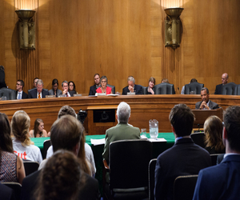
US Senate skeptics 2009: “CO2 was >2000 ppm for millions of years in earlier earth. Didn’t life just go on as usual? How bad could it be?”
No one in the room knew,
but I decided to find out

Slide 4
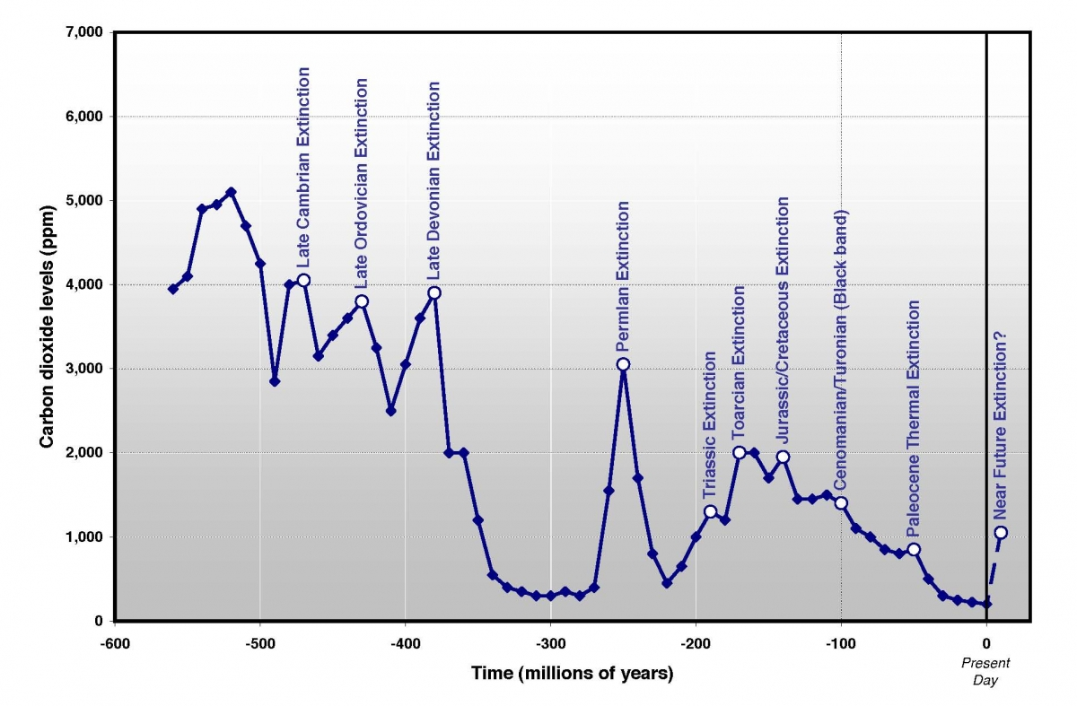
H2S in air
And
Radiation
Enough
To kill
All humans
NSF Geosciences sponsored best data on past:
Graph from Peter Ward, Under a Green Sky, adapted by Englander. Ward theory half right.

Slide 5
NOAA data: 40 years for Pacific O2?

Slide 6
Comparing Sources in 2022:
Bad News
See Preface by Ward, Wadhams, Werbos
Started with discussion comparing past extinction science and new ocean current data, drawing on new work by Kump, Kirschvink, Hazen
  posted at https://tosavetheworld.ca/

Slide 7
Comparing Sources in 2022:
Bad News
MAIN CAUSE OF PAST EXTINCTIONS:
  low O2 in deep ocean
  High fertilization in major sources of ocean currents like Humboldt and Gulf Stream
Latest data says problems coincide, worst case, soon

Slide 8
Policy and Investment
On reliable solutions, IEEE and NSF have been imperfect, but provide uniquely rich sources of real frontline information.
IEEE needs to reach Policy Makers and Investment Information Networks

Slide 9
Real Solutions vs. Conflicts of Interest
Many EU climate activists claim they already have solutions.
  Von Der Leyen’s more serious evaluation shows otherwise.
  Frightening dependence on fossil imports for years to come.
IEEE and NSF review systems, when used at their best, provide deeper evaluation and ability to map richer set of options from open large sets of credible sources.

Slide 10
What’s Important for CO2:
Data from DOE/EIA-0573 (2009)
Total US CO2 emissions: 5426 million tons (Table 7, page 22)
  2160 direct CO2 from electric utilities
  1854 direct from transportation
  1412 all other places, including electricity generation by industry and commercial sectors
1404 is the total emissions of industry (direct plus indirect)

Slide 11
5 Point Plan To Reduce the Worst Climate Risk
1.Sectoral Bill:
Cut net GHG in
Electricity Generation
5. New Basic R&D:
Ocean options,
Archaea, currents
2.Sectoral Bill:
Cut net GHG in
Cars and Trucks
π
4. Geoengineering:
R&D for better
options from aerosols
to mirrors to..
3.Agriculture:
Recycle $20-$40/ton
CO2 fee to recycle CO2
From terra preta to happy cows

Slide 12

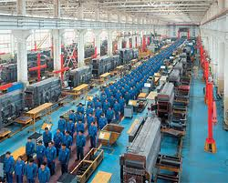


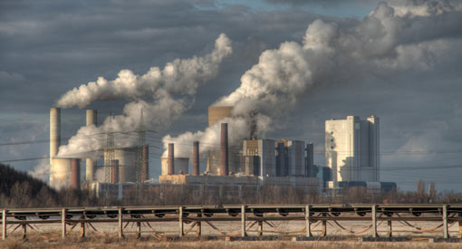
About 10 Independent Systems Operators (ISOs) Run the US Grid
Transco
like IOU
ISOs Decide:
Unit Commitment (Contracts to Generators a Day Ahead) & Advance Planning
Economic Dispatch (Generators Used and Loads & Prices every 15 minutes)
Balancing Authorities:
  Regulation Functions (every 2 seconds): stability, ∨,υ
Big Loads
?
Distribution
Companies Discos
Small Loads
See www.ferc.com, event calendar, June 2010

Slide 13
“NSF is currently supporting research to develop a ‘4th generation intelligent grid’ that would use intelligent sytem-wide optimization to allow up to 80% of electricity to come from renewable sources and 80% of cars to be pluggable electric vehicles (PEV) without compromising reliability , and at minimum cost to the Nation (Werbos 2011).”
obamawhitehouse.archives.gov/sites/default/files/
microsites/ostp/nstc-smart-grid-june2011.pdf
(or search on White House smart grid 2011)

Slide 14

IEEE COMPUTATIONAL INTELLIGENCE MAGAZINE
AUGUST 2011
Also posted at www.Werbos.com/energy.htm

Slide 15
Three Requirements for Affordable Renewable Electricity
Less cost to generate enough for national needs
Storage to supply it when you use it
Intelligent grid to make ful use of storage,
Which requires FORESIGHT in FACE OF UNCERTAINTY ** RLADP, NSF 1988--

Slide 16
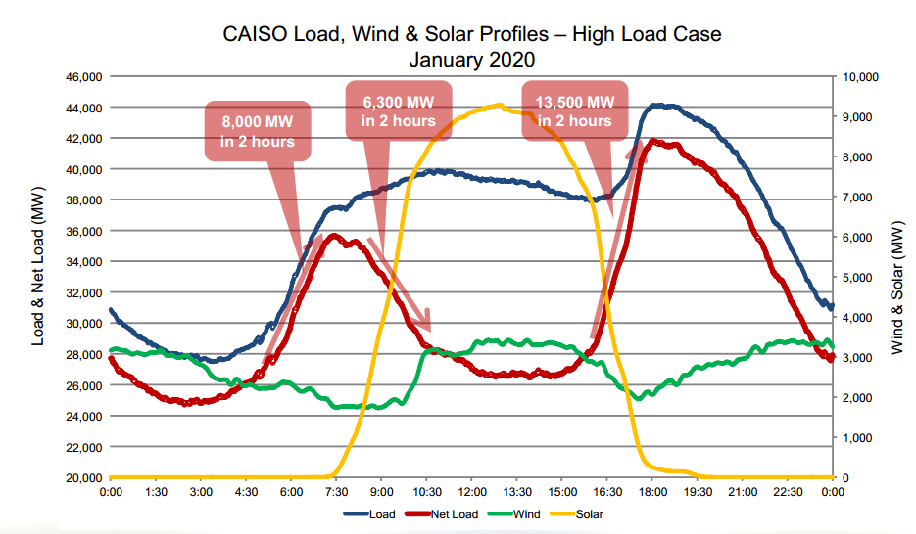
Time of day and predictability are crucial
Demand
Demand
Minus
2020 solar
Wind
Chile and Brazil have unique hydro base, so intelligent timing of its use avoids need for more storage
Most of rest of world faces tricky choices, 10¢ extra

Slide 17
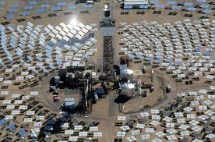

2016: 3¢/kwh PPAs based on solar cells seemed safe for Chile, but time of day, backup issues and decline of subsidies from China made real cost much higher
Power towers now look much better, with breakthrough efficiency in heat to kwh and in thermal storage, better than batteries, now mainstay for Chile
Important experience from Stirling solar farms can transfer to even better in power towers

Slide 18
Neural Nets for the Power Grid 16 Years Later*
Opportunities for Neural Nets As Such in Grids
Crucial Issues in Partner Technologies for Grid
  Cybersecurity and cyberblitkrieg
  New technology for renewables
  New power electronics, motors, fuel flexibility
Power grids can lead development of more sustainable “Internet of Things” (IOT)
IOT challenges in general
*www.werbos.com/E/GridIOT.pdf

Slide 19
Biggest Opportunities for true Intelligent optimization (RLADP) in US Power Grid and Many Others
ISO Level
Distribution Level
User Level
New extension - quantum RLADP

Slide 20
ISO Level: Cut Cost of Renewables in Half
  FORESIGHT: From Optimal Power Flow to DSOPF, allows optimal management of storage, dams, time of day
  Speed: Implementation on Neural Net Chips, allows optimization every second, not every 5 minutes. Control of power electronics turns wind from cost to asset
Distribution Level: Enable Optimal Control
  Use meshed networks, handle electric cars and PHEV
User Level: (Mannheim) Intelligent Demand Response Can Accommodate Even Wind
New Technology Quantum RLADP can handle more complicated decision problems (IEEE QCE 2021)

Slide 21
Oil and Economic Security
In the Coming Decade
Before the September 2008 economic collapse: oil (Brent) about $150/barrel and rising, half due to expectations – Hotelling rent
**IF** world economy recovers, many project about $200/barrel… a $ trillion/year bill for US.. more serious than federal deficit. (Latin American experience.) Crucial to hope of real recovery!
Expectations can change quickly if trends and plans change.
See www.werbos.com/oil.htm from Specter…

Slide 22
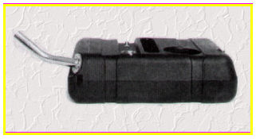
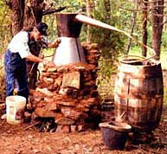
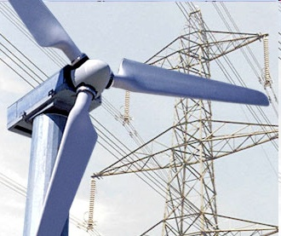
Optimal Strategy for Total Energy Security
Maximize
Fuel-Flexible
Plug-in Hybrid Cars
Open door
to US natural
gas (e.g. to
trucks) while
it lasts
R&D for
more efficient
use of diverse
fuels
R&D for
batteries for
affordable
electric
cars
Maximize supply of
Alternate liquid fuels
– Not oil
– Incentives, standards and R&D
Minimize cost
and then
maximize supply of
renewable electricity

Slide 23
Plug-in Hybrids (PHEV) : A Large-Scale Opportunity Here and Now
Hybrids cut liquid fuel use 50% already. Plug-ins cut 50% of that.
  “Researchers have shown .. (PHEV) offering.. electric range of 32 km will yield… 50% reduction..” (IEEE Spectrum, July/05). Shown in working Prius.
Battery breakthroughs in China: from 10/07, 10kwh batteries (larger than) cost $2,000. www.thunder-sky.com. Thus an extra $2,000 per car can cut gas dependence in half.
Gives economic security in case of sudden gasoline cutoff.
Does not strain grid – actually strengthens it, if done right
Notes:
This slide is self-explanatory (I hope).
This is a real picture of a real working plug-in hybrid Prius, published in IEEE Spectrum – the flagship magazine of IEEE, the world’s largest engineering society. (Over 300,000 members.) Much of what I have learned about these technologies comes from meetings of IEEE technical societies; I serve on the governing boards (“AdComs”) of two of them, and have worked a lot with others. This is real stuff, not advocacy politics.
Plug-ins are real today – but not cheap today, and not yet mass-produced (though I hope we may be close). The biggest technical problem is the cost of the batteries. In fact, Toyota now says that supplies of state-of-the-art batteries are the main factor limiting their sales of hybrid cars (which have been doubling every year for some time, with lots of people in line to try to buy them). DOE and the US auto industry almost gave up on developing breakthrough batteries decades ago – but the electronics industry did not give up. Major breakthroughs have been made, mainly by people building laptops and cell phones – but the technology carries over.
However – the core electronics manufacturing centers in the world are no longer in the US, even for US-designed and US-owned products. Most of the engineers are not US born even here. A recent pie chart of lithium battery production shows 46% in Japan and 46% in China and Korea. Batteries are available in China today far beyond what the US makers of plug-ins seem to have access to. They are still not cheap – but with more competition, and a solid need for the product, it is a very important option to push as hard as we can.

Slide 24
GEM Flexibly Fuel Vehicles (FFV)
One Tank To Hold Them All
G: Gasoline
E: Ethanol
M: Methanol
With an FFV, you choose each day which to buy
At $100-200/car, a more open competition, level playing field,
better unleash the power of the free market
GEM flexibility ⇒ use of any corrosive fuel, adaptive engine control
Notes:
The GEM flexibly fueled car is the key to the transition to sustainable car fuel, if we want to get to anything else but a pure electric car. (Even then, hybrid cars can be made flexible.)
The key point is that GEM flexibility is HERE TODAY. It’s not mainly a subject for research. It’s ready for mass deployment. It is the one and only option we have at hand right now to break the chicken and egg cycle soon enough to deploy advanced independent cars before 2030 in large numbers.
And – it’s not very expensive. If you compare the $100-200 per car to achieve “fuel insurance” for the life of a car, that’s a whole lot less than what we all pay every year for accident insurance. And maybe for most of us, the chances of a big accident in the next 20 years are less than the chances of some problems in the Middle East. Or, to put it another way, this flexibility would give the car buyer a chance to buy something else besides gasoline on days when the price of gasoline is too high. Many, many Brazilians have been grinning this year about how they didn’t have to buy gasoline when the price was rising so much all over the world.
To really accelerate the development of methanol and ethanol fuels, without creating subsidies, we could simply REQUIRE that new gasoline-carrying cars should have GEM flexibility. Yes, this would be a legal intervention – but it would actually STRENGTHEN market forces because it would open the door to more competition. In many ways, it would be like the imposition of common standards for communication interfaces and common carriers; they do require laws, but their EFFECT is to open up more competition. This is a case where more competition may be a life-or-death matter for national security, and we need it as fast as we can get it. GE flexible cars have been penetrating the markets without special laws in Brazil – but we need three-way flexibility, and we cannot afford to wait.

Slide 25
We can dramatically reduce cost and expand supply of biofuel, present and future, if we stop requiring so much purity in our ethanol/alcohol!
We need to give this guy permission to compete with Saudi Arabia and Iran
for the car fuel market! He doesn’t need a subsidy – only more freedom
and an open door! Just give him a chance, and within 15 years…
(Also, try a google on “forest industry” methanol.)
Notes:
There are lots of people out there who want to spend billions of dollars over a few decades, in order to improve our ability to make pure ethanol from “cellulosic” sources like wood or grass. But why restrict it to pure ethanol? People have known for decades or even centuries how to make MIXED ALCOHOLS or other useful fuels from wood. Ever hear of “wood alcohol?”
We don’t need to wait decades for a technology to make wood alcohol. It’s already in existence, for decades and decades. What’s more – there is a lot more efficiency and a lot less waste when we make the kinds of fuels nature wants us to make, instead of demanding pure ethanol. Farmers can make a lot more money by making and selling these other kinds of fuels, because they can make more fuel per ton of biomass at a lower cost.
What we need is a MARKET for what we already know how to make.
We need cars which can USE these easier types of alcohol and biofuel…
and that turns out to be a whole lot cheaper than doing things the hard way.
CAVEAT: R&D on new, advanced biofuel production technology could be a big help here, IF WE move immediately to open up the market for ALL these alternative liquid fuels, ethanol included. GEM fuel flexibility will do this, because it requires a general ability to handle liquids as corrosive as methanol, and adaptive engine control.

Slide 26
What limits rate of deployment of hybrids & plug-ins? Cost, cost, cost…
(and recharge: don’t fall into chademo!)
Hybrid Prius vs. regular Prius: cost penalty = $3000 (2006 data Car & Driver, Financial Times) about enough to pay off at $3-4/gallon without interest
About $2000 of the $3000 is for small fast battery, currently nickel hydride less than 1kwh.
$1,000-$2,000 tax incentive per car, for the first million hybrids from each manufacturer, essential to speed of development, becoming cheaper, in US
Outside the US, higher gas price bigger market now

Slide 27
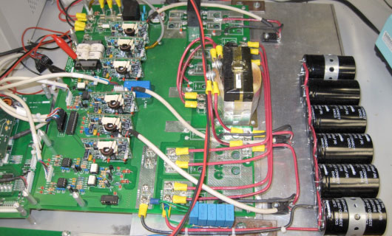
Example 1 of Funded Work: Alireza Khaligh IIT
(Similar megawatt work by SMazumder for solar farms)
New integrated power electronics can cut cost of total power electronics for cars
like Volt by 1/3 – 1/2 while adding a flexible AC/DC fast recharge capability
making fast recharge stations “free” instead of $100,000-$200,000 each
Similar technology crucial to distribution level (Rahman issues) constraints

Slide 28

To The Rescue: Lonnie G. Johnson
Founder and President Johnson Research
NASA (Voyager, Mars Observer, CRAF, Cassini, Galileo)
Holds over 140 patents
National Inventor’s Hall Of Fame Inductee
Currently Focused on Energy Technology Breakthroughs
  Solid State JTEC Engine for Direct Heat to Electric Conversion
  High Capacity Solid State Ceramic/glass electrolyte batteries
  High Specific Energy Lithium Air Batteries
“One of the Top Inventors in the World”
Time Magazine
Exciting credible new ideas (risky but near term) for US to leapfrog the world both
in batteries and in more efficient heat-to-electricity for flexible cars !!!!!!!

Slide 29

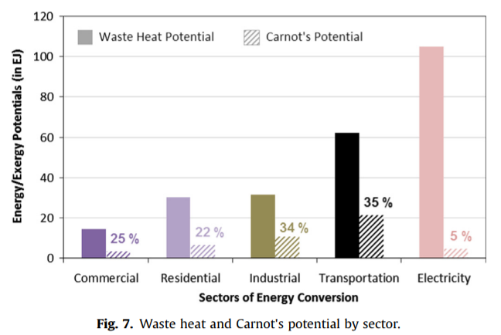
Johnson Thermo-Electrochemical Converter (JTEC)
Uniquely suited to produce electricity using primary heat sources as well as abundant low temperature waste heat
At JTEC’s 70% of Carnot conversion efficiency, global waste heat sources would yield 9.1 * 1012 kWh of Electricity
  Value at Cost of Electricity from Nuclear Power = $190B
  Value at Cost of Electricity from Petroleum = $1.9T
<100ºC
At ideal Carnot efficiency, available global waste heat can produce 47 exa-Joules of electricity
>300ºC
100ºC to 199ºC
22Ej
7Ej
11Ej
4Ej
3Ej
Waste heat potential Renewable and Sustainable Energy Reviews 57 (2016) 1568–1579
JTEC’s Versatility Featured on the Cover of the January 2020 Issue of the American Chemical Society Publication
On average, in 2011, nuclear power had the lowest electricity production costs at $0.0210 cents per kilowatt hour, and petroleum had the highest at $0.216 cents per kilowatt hour.
https://instituteforenergyresearch.org/analysis/electric-generating-costs-a-primer/

Slide 30
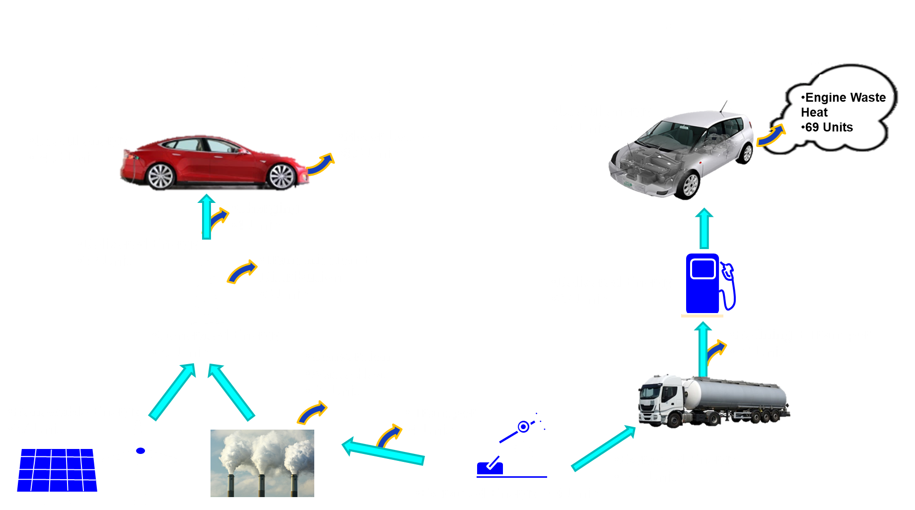
Johnson’s All Solid State Ceramic/glass Batteries Will Make Electric Vehicles Safer and More Affordable

Slide 31

Johnson’s Approach To Li-Air Will Provide Critically Needed Electric Vehicle Performance
Lithium Air Will Store 2000Wh/kg Vs. Lithium Ion’s Only 200Wh/kg
  777 Class Passenger Aircraft Fuel Costs are $17.86/mi
Cut to $4.20/mi with Lithium Air at current power utility rates

Slide 32
What We Have Missed: Links to Other Existential Risks & Hope (section 5)
New Internet Risks AGI/IOT even bigger, sooner, related to IEEE, but climate is an important testbed, even for Quantum AGI (AGI), patent
Misuse of nuclear and biotech still threaten human existence. Agriculture linked to biotech and internet fintech, wanted a whole section for the book
Human potential offers great hope of better future if we improve our networks better

Slide 33
Extra Slides In Case of Questions

Slide 34
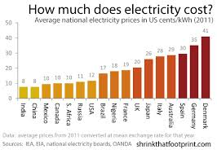
US and EU are already above 10 cents per kwh. China is less, but heavily
subsidized, encountering shortages and price rises with coal (not counting CO2)
OECD/IEA: world uses 21 thousand terawatt hours per year (2011). At 10 cents per kwh, that is worth $2 trillion per year. With wind or solar supplying all, that would double or more. (Storage needs, backup, regulation.)

Slide 35
Will Euxinia Kill All Humans?
How Big is the Risk, How Soon?
Dr.Paul J. Werbos
Research Program Director, National Science Foundation 1988-2015 (“AI”, power grids,quantum)
Detailed to Senator Specter/EPW in 2009
Search on “Werbos” at youtube
Still active in IEEE and many other professional groups like Chile Solar Energy Research Consortium

Slide 36

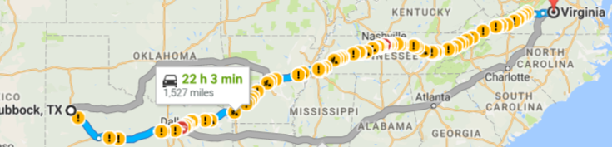
Proposed Start: 10 gigawatts on new line as long as TX→PJM 2¢/kwh
1gw→2.8TWH/year. With (10¢-3¢-2¢)*28TWH,
$1.5 billion/year extra profit on $3b investment

